Slide 1

Machine Learning
Lecture 1 – Regression Analysis

Slide 2
Overview
Concepts
Regression Analysis
Linear Regression
Optimization Methods
Logistic Regression
Polynomial Regression
Regularization
Choosing an Algorithm

Slide 3
Basic ML Concepts
Model: A machine learning algorithm.
Fitting: A model trained in a dataset to learn patterns, relationships, or trends within that data.
Underfitting: A model achieves poor performance in the training data.
Overfitting: A model achieves great performance in the training data, but it fails to generalize well in unseen data.
Generalization: The model’s ability to make good prediction in both training and unseen data.
Weights/Coefficients: The parameters of a model that need to be found by training it in a dataset.
Hyperparameters: The settings of an ML algorithm.
Hyperparameter Tuning: The process in which several hyperparameters are adjusted for a specific dataset.
Observations/Samples: The number of paradigms in a dataset.
Features: The attributes of an observation (e.g. the features of a weather dataset could include Temperature, Humidity, Atmospheric Pressure, etc.).

Slide 4
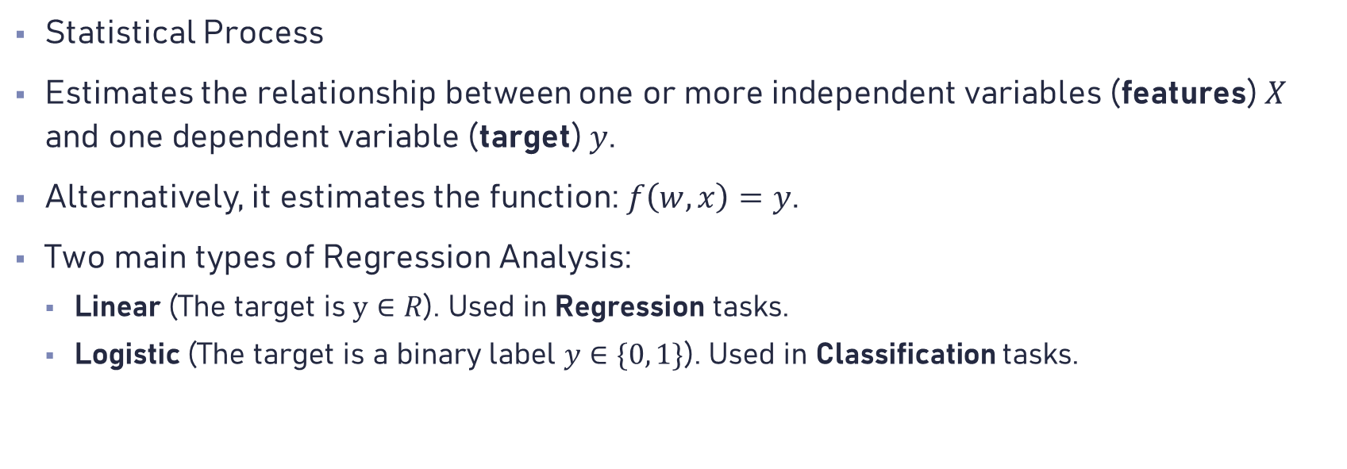
Regression Analysis
Statistical Process
Estimates the relationship between one or more independent variables (features) $X$ and one dependent variable (target) $y$.
Alternatively, it estimates the function: $f\left(w,x\right)=y$.
Two main types of Regression Analysis:
Linear (The target is $y∈R$). Used in Regression tasks.
Logistic (The target is a binary label $y∈\{0, 1\}$). Used in Classification tasks.

Slide 5
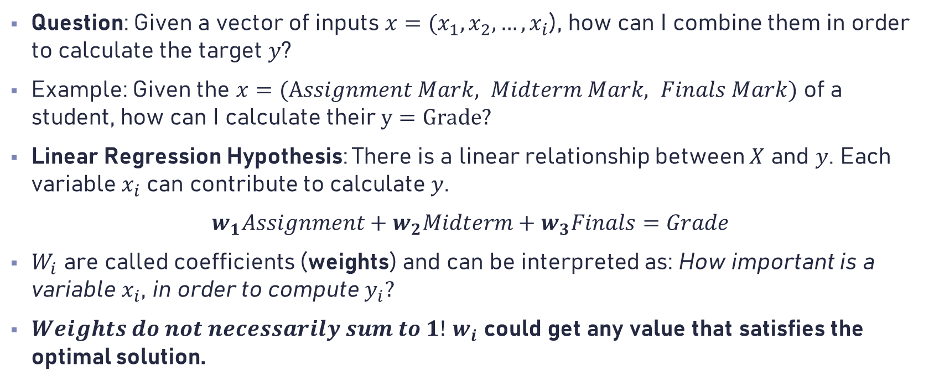
Linear Regression (1)
Question: Given a vector of inputs $x=(x_{1},x_{2},…,x_{i}$), how can I combine them in order to calculate the target $y$?
Example: Given the $x=(Assignment Mark, Midterm Mark, Finals Mark)$ of a student, how can I calculate their $y=Grade?$
Linear Regression Hypothesis: There is a linear relationship between $X$ and $y$. Each variable $x_{i}$ can contribute to calculate $y$.
$w_{1}Assignment+w_{2}Midterm+w_{3}Finals=Grade$
$W_{i}$ are called coefficients (weights) and can be interpreted as: How important is a variable $x_{i}$, in order to compute $y_{i}?$
$Weights do not necessarily sum to 1!$ $w_{i}$ could get any value that satisfies the optimal solution.

Slide 6
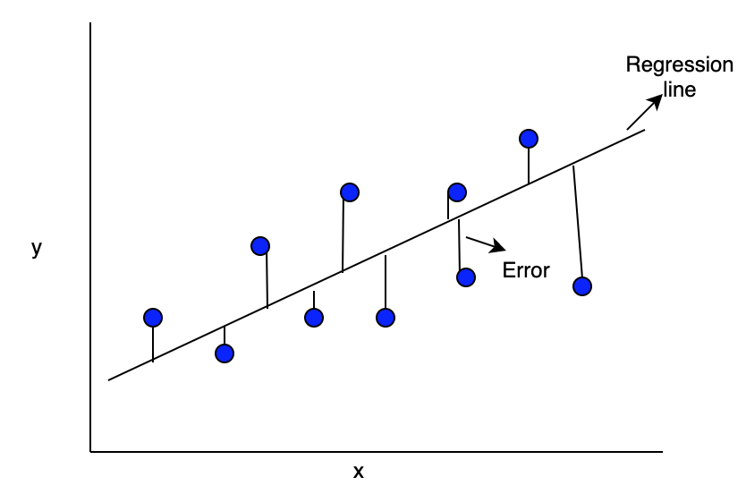

Linear Regression (2)
Let there be a dataset $\left(X,y\right)$, where $y∈R$.
The goal is to find a function $f\left(x\right)=y$ for every given training point (sample) $x$.
$f$ can be calculated as a Regression Line $L$: $y=ax+b$.
Alternatively: $Y=wx+w_{0}$ or $y=WX$

Slide 7
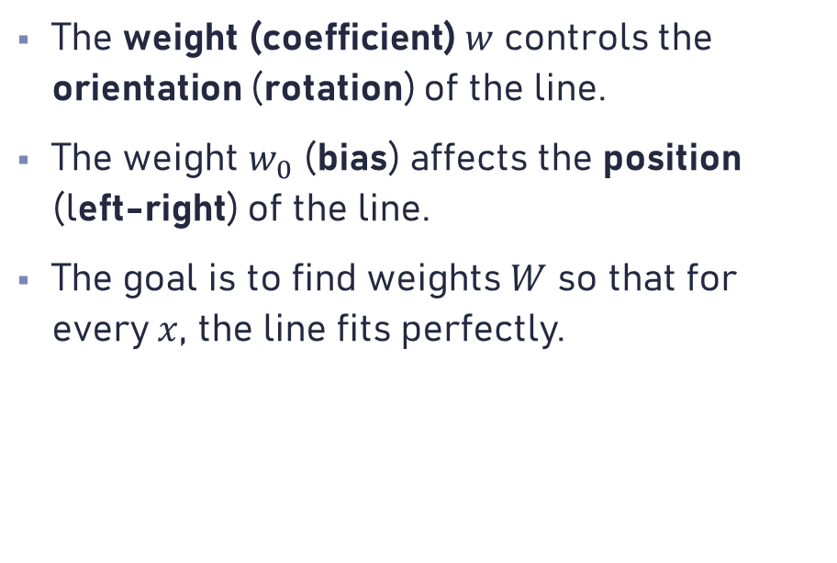



Linear Regression (3)
The weight (coefficient) $w$ controls the orientation (rotation) of the line.
The weight $w_{0}$ (bias) affects the position (left-right) of the line.
The goal is to find weights $W$ so that for every $x$, the line fits perfectly.
$$y=wx$$
$$w$$
$$w_{0}$$

Slide 8
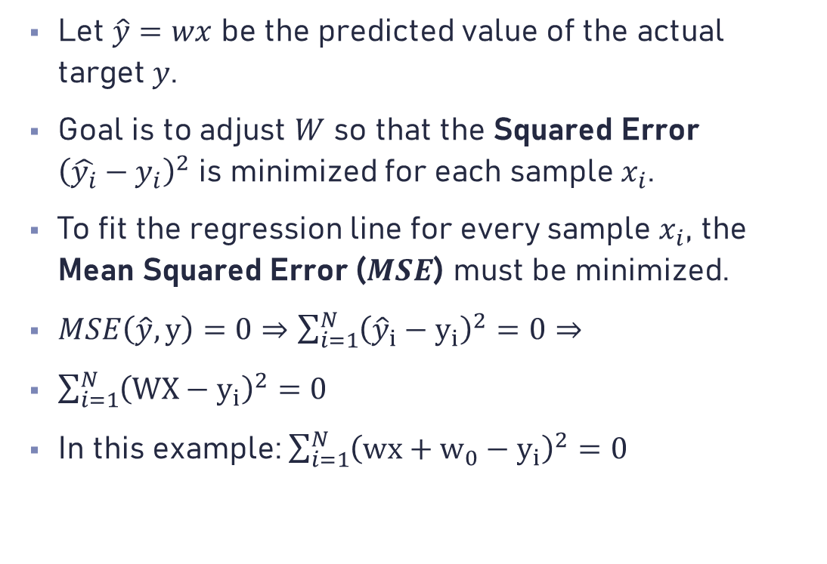



Linear Regression (4)
Let $\hat{y}=wx$ be the predicted value of the actual target $y$.
Goal is to adjust $W$ so that the Squared Error ${\left(\hat{y_{i}}−y_{i}\right)}^{2}$ is minimized for each sample $x_{i}$.
To fit the regression line for every sample $x_{i}$, the Mean Squared Error ($MSE$) must be minimized.
$MSE\left(\hat{y},y\right)=0⇒\sum_{i=1}^{N}{{\left({\hat{y}}_{i}−y_{i}\right)}^{2}}=0⇒$
$\sum_{i=1}^{N}{{\left(WX−y_{i}\right)}^{2}=0}$
In this example: $\sum_{i=1}^{N}{{\left(wx+w_{0}−y_{i}\right)}^{2}=0}$
$$y=wx$$
$$w$$
$$w_{0}$$

Slide 9
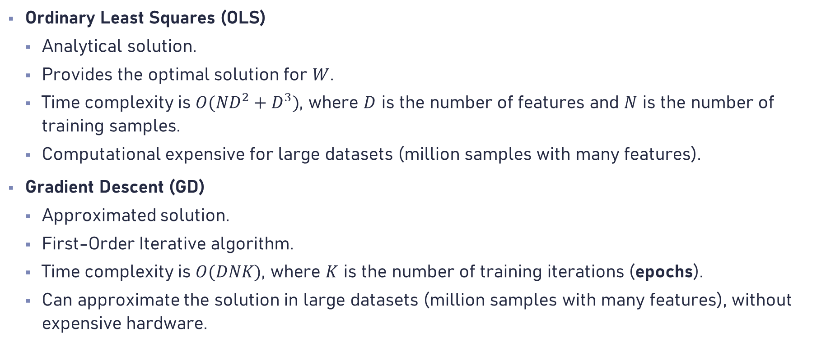
Optimization Methods (1)
Ordinary Least Squares (OLS)
Analytical solution.
Provides the optimal solution for $W$.
Time complexity is $O({ND}^{2}+D^{3})$, where $D$ is the number of features and $N$ is the number of training samples.
Computational expensive for large datasets (million samples with many features).
Gradient Descent (GD)
Approximated solution.
First-Order Iterative algorithm.
Time complexity is $O(DNK)$, where $K$ is the number of training iterations (epochs).
Can approximate the solution in large datasets (million samples with many features), without expensive hardware.

Slide 10
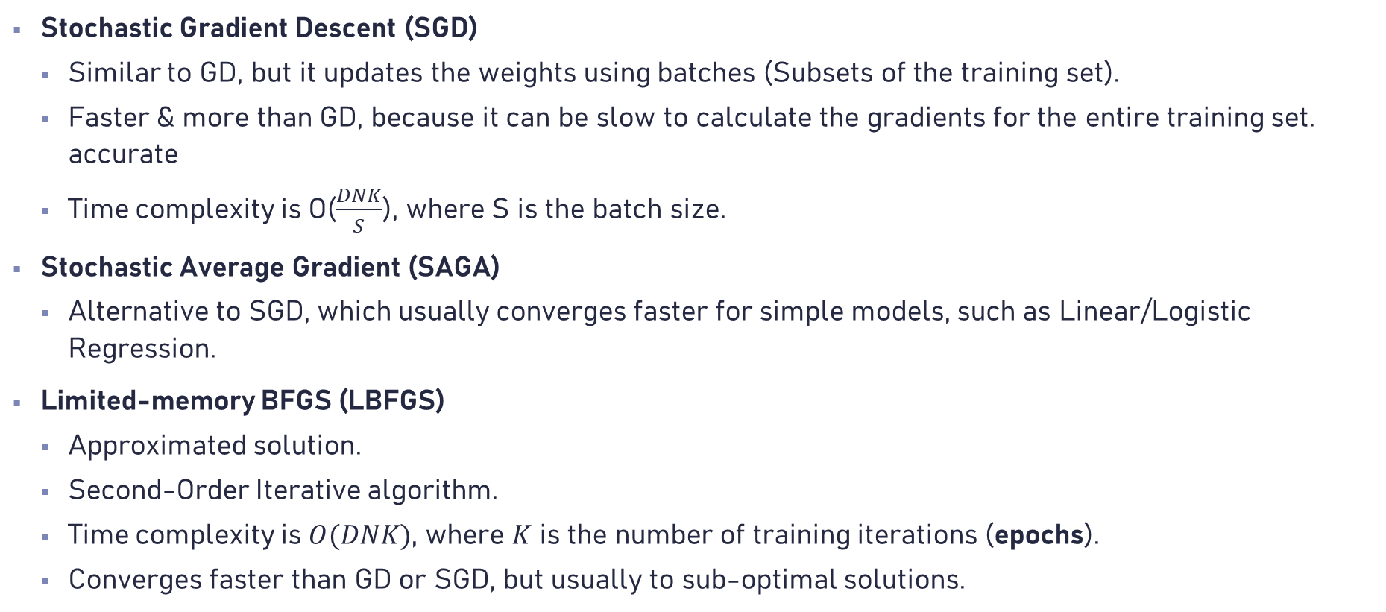
Optimization Methods (2)
Stochastic Gradient Descent (SGD)
Similar to GD, but it updates the weights using batches (Subsets of the training set).
Faster & more than GD, because it can be slow to calculate the gradients for the entire training set. accurate
Time complexity is O($\frac{DNK}{S}$), where S is the batch size.
Stochastic Average Gradient (SAGA)
Alternative to SGD, which usually converges faster for simple models, such as Linear/Logistic Regression.
Limited-memory BFGS (LBFGS)
Approximated solution.
Second-Order Iterative algorithm.
Time complexity is $O(DNK)$, where $K$ is the number of training iterations (epochs).
Converges faster than GD or SGD, but usually to sub-optimal solutions.

Slide 11
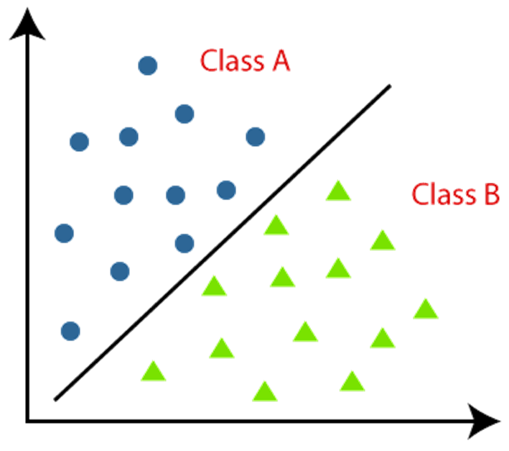


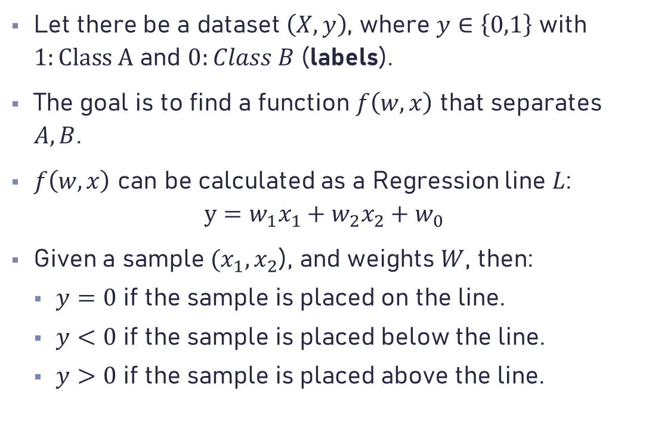



Logistic Regression (1)
$$x_{2}$$
$$y=0$$
Let there be a dataset $\left(X,y\right)$, where $y∈\left\{0,1\right\}$ with $1:Class A$ and $0:Class B$ (labels).
The goal is to find a function $f\left(w,x\right)$ that separates $A,B$.
$f\left(w,x\right)$ can be calculated as a Regression line $L$: $y=w_{1}x_{1}+w_{2}x_{2}+w_{0}$
Given a sample $(x_{1},x_{2}$), and weights $W$, then:
$y=0$ if the sample is placed on the line.
$y<0$ if the sample is placed below the line.
$y>0$ if the sample is placed above the line.
$$y>0$$
$$y<0$$
$$x_{1}$$

Slide 12
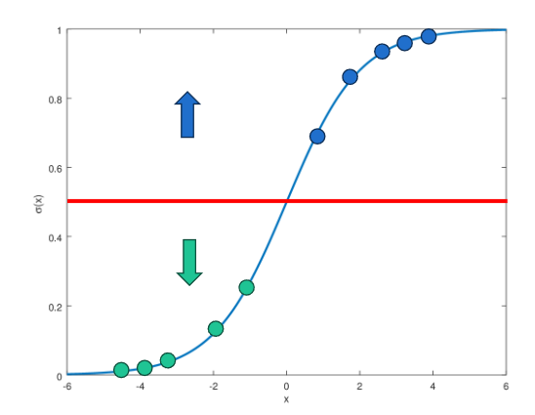
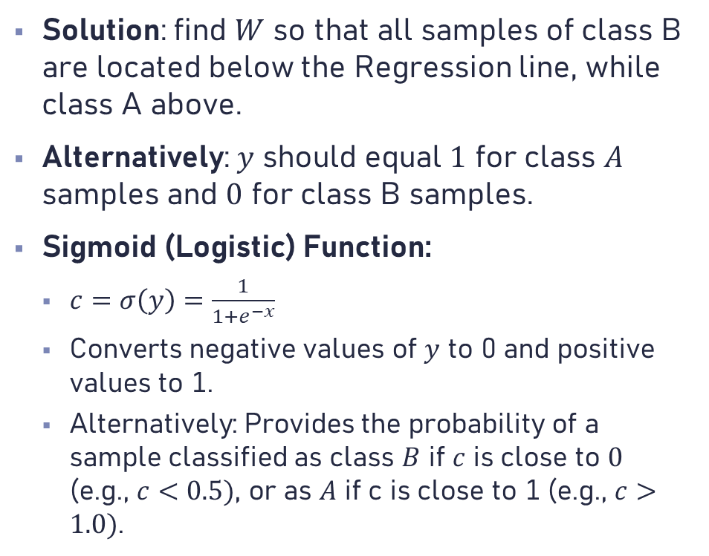
Logistic Regression (2)
Solution: find $W$ so that all samples of class B are located below the Regression line, while class A above.
Alternatively: $y$ should equal $1$ for class $A$ samples and $0$ for class B samples.
Sigmoid (Logistic) Function:
$c=σ\left(y\right)=\frac{1}{1+e^{−x}}$
Converts negative values of $y$ to 0 and positive values to 1.
Alternatively: Provides the probability of a sample classified as class $B$ if $c$ is close to $0$ (e.g., $c<0.5)$, or as $A$ if c is close to 1 (e.g., $c>1.0)$.

Slide 13

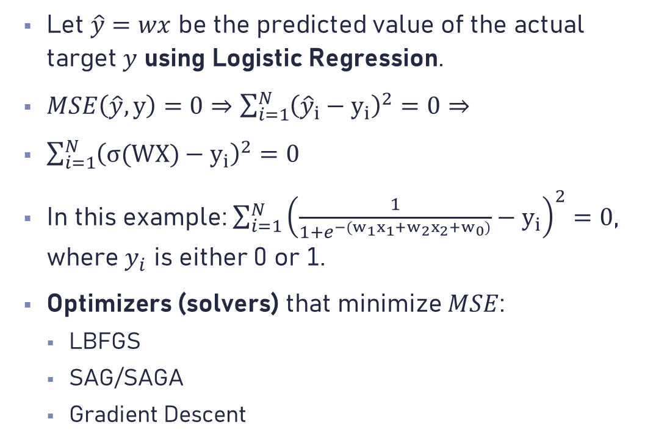


Logistic Regression (3)
$$x_{2}$$
$$y=WX$$
Let $\hat{y}=wx$ be the predicted value of the actual target $y$ using Logistic Regression.
$MSE\left(\hat{y},y\right)=0⇒\sum_{i=1}^{N}{{\left({\hat{y}}_{i}−y_{i}\right)}^{2}}=0⇒$
$\sum_{i=1}^{N}{{\left(σ(WX)−y_{i}\right)}^{2}=0}$
In this example: $\sum_{i=1}^{N}{{\left(\frac{1}{1+e^{−(w_{1}x_{1}+w_{2}x_{2}+w_{0})}}−y_{i}\right)}^{2}=0}$, where $y_{i}$ is either 0 or 1.
Optimizers (solvers) that minimize $MSE$:
LBFGS
SAG/SAGA
Gradient Descent
$$x_{1}$$
$$u=σ\left(y\right)$$
$$class=\{\begin{matrix}0, u≤0.5 \\ 1,u≥0.5\end{matrix}\}$$

Slide 14
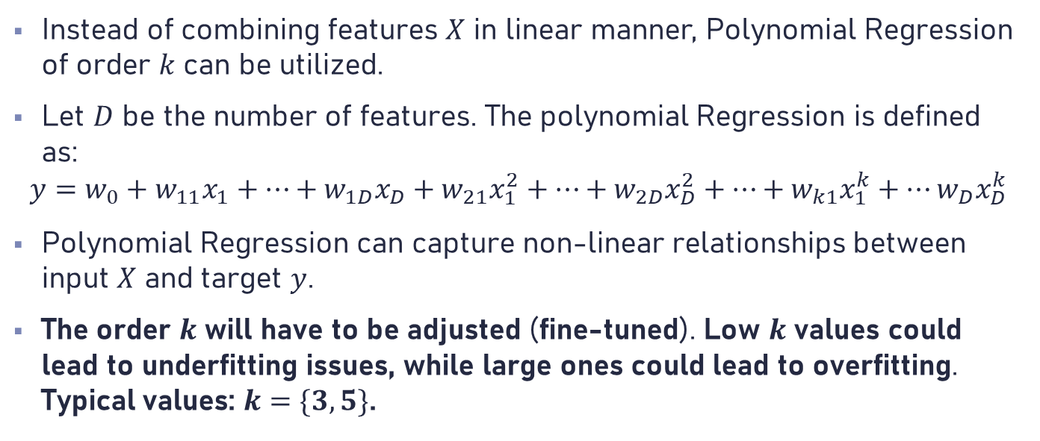
Polynomial Regression (1)
Instead of combining features $X$ in linear manner, Polynomial Regression of order $k$ can be utilized.
Let $D$ be the number of features. The polynomial Regression is defined as:
$$y=w_{0}+w_{11}x_{1}+…+w_{1D}x_{D}+w_{21}x_{1}^{2}+…+w_{2D}x_{D}^{2}+…+w_{k1}x_{1}^{k}+…w_{D}x_{D}^{k}$$
Polynomial Regression can capture non-linear relationships between input $X$ and target $y$.
The order $k$ will have to be adjusted (fine-tuned). Low $k$ values could lead to underfitting issues, while large ones could lead to overfitting. Typical values: $k=\{3, 5\}$.

Slide 15
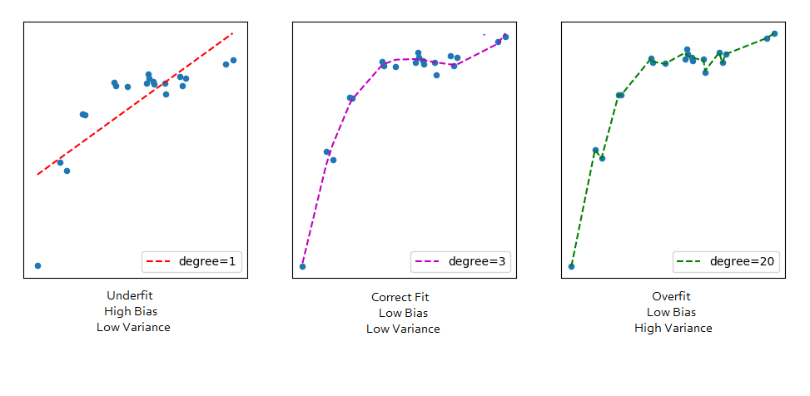
Polynomial Regression (2)

Slide 16
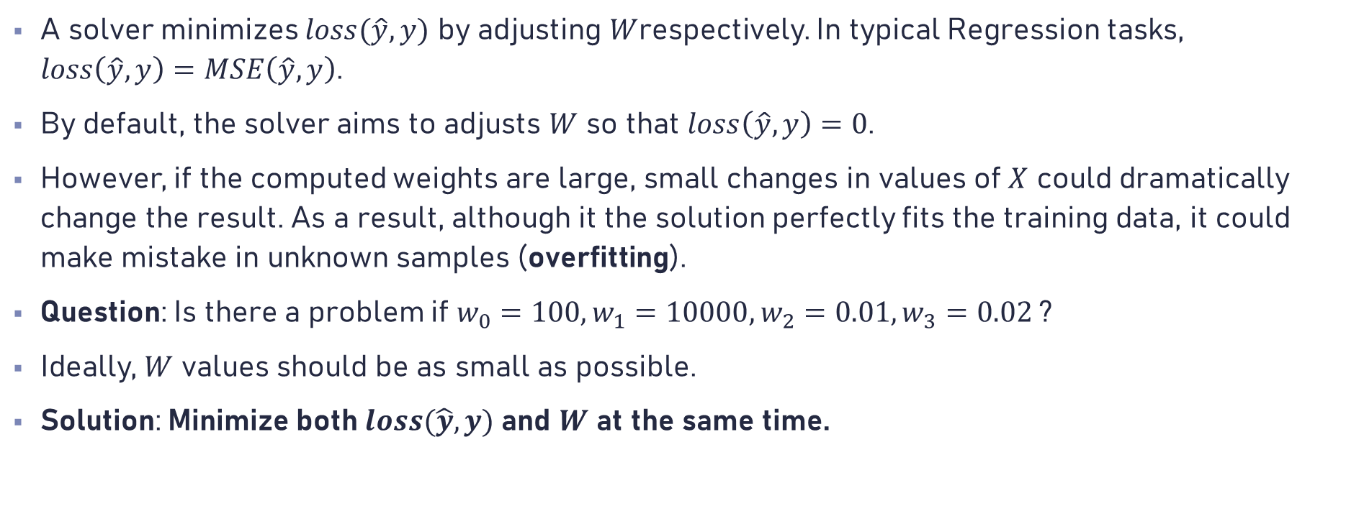
Regularization (1)
A solver minimizes $loss(\hat{y},y)$ by adjusting $W$respectively. In typical Regression tasks, $loss\left(\hat{y},y\right)=MSE\left(\hat{y},y\right)$.
By default, the solver aims to adjusts $W$ so that $loss\left(\hat{y},y\right)=0$.
However, if the computed weights are large, small changes in values of $X$ could dramatically change the result. As a result, although it the solution perfectly fits the training data, it could make mistake in unknown samples (overfitting).
Question: Is there a problem if $w_{0}=100, w_{1}=10000, w_{2}=0.01, w_{3}=0.02$?
Ideally, $W$ values should be as small as possible.
Solution: Minimize both$loss(\hat{y},y)$ and $W$ at the same time.

Slide 17
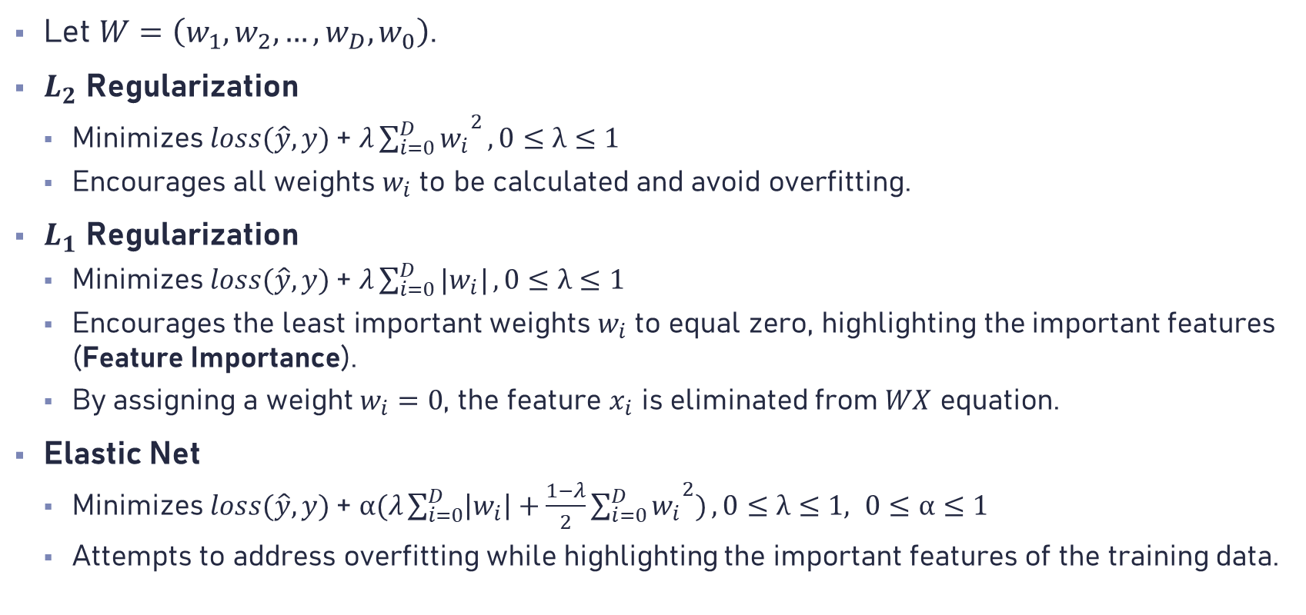
Regularization (2)
Let $W=\left(w_{1},w_{2},…,w_{D},w_{0}\right)$.
$L_{2}$ Regularization
Minimizes$loss(\hat{y},y)$ + $λ{\sum_{i=0}^{D}{w_{i}}}^{2},0≤λ≤1$
Encourages all weights $w_{i}$ to be calculated and avoid overfitting.
$L_{1}$ Regularization
Minimizes$loss(\hat{y},y)$ + $λ\sum_{i=0}^{D}{|w_{i}|},0≤λ≤1$
Encourages the least important weights $w_{i}$ to equal zero, highlighting the important features (Feature Importance).
By assigning a weight $w_{i}=0$, the feature $x_{i}$ is eliminated from $WX$ equation.
Elastic Net
Minimizes$loss(\hat{y},y)$ + $α(λ\sum_{i=0}^{D}{\left|w_{i}\right|+\frac{1−λ}{2}{\sum_{i=0}^{D}{w_{i}}}^{2})},0≤λ≤1, 0≤α≤1$
Attempts to address overfitting while highlighting the important features of the training data.

Slide 18
Choosing an Algorithm
There is no way (yet) to know which algorithm works best for each problem.
The utilization of an algorithm depends on the following factors:
Explainability / Interpretability
Accuracy / Robustness
Execution Time
Hardware Limitations
Implementation
Example 1: Although Polynomial regression might be more accurate than Linear regression, it could be less preferable, as Linear regression is more explainable.
Example 2: The Implementation & Hyperparameter Tuning of a Deep Neural Network might be challenging and Time-Consuming in comparison to a Linear Regression Module.

Slide 19
Machine Learning
Lecture 1 – Regression Analysis

